Slide 1

AIRLINE RESERVATION SYSTEM

Slide 2
Agenda
Project overview
Project requirements
System functionality

Slide 3
PROJECT REQUIREMENTS
Eclipse Platform version 3.2.0
J Boss-4.0.2
Oracle SQL*Plus Version 10.2.0.1.0

Slide 4
PROJECT OVERVIEW
The main objective of this project is to design and develop an Airline Reservation System with user authentication.
This project is mainly intended for the customers to book flight tickets online which requires user pre-registration.
To register on the site the user has to provide his details for future contact.

Slide 5
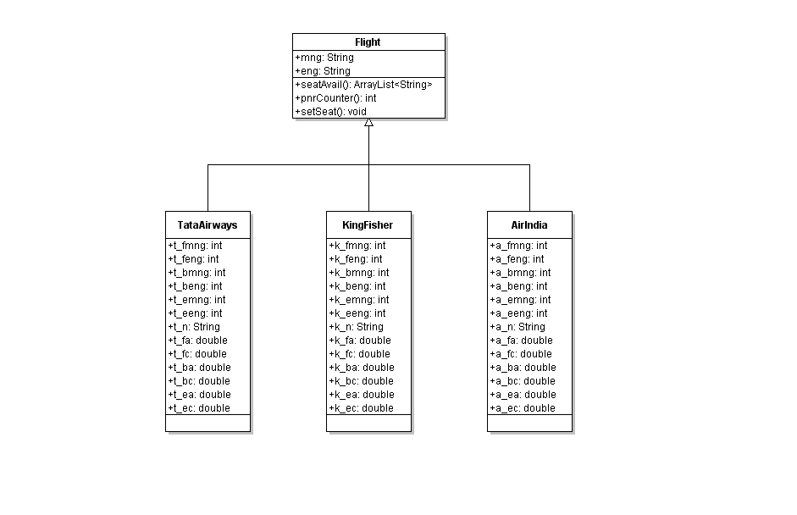

Slide 6
SYSTEM FUNCTIONALITY
The functionality of the project is to store all the details provided by the registered user in the database.

Slide 7
User Functionality
New Registration
Login
Booking tickets
Print the tickets based on the PNR no
Check PNR status
Contact the system administrators based on the contact details given in the site

Slide 8
Administrator Functionality
Add/Delete/Modify customer information in the database.
Add/Delete/Modify flight related information related to corresponding PNR no
Check seat availability of the corresponding flight using the database.
Check no. of successfully bookings till now using database PNR counter.

Slide 9
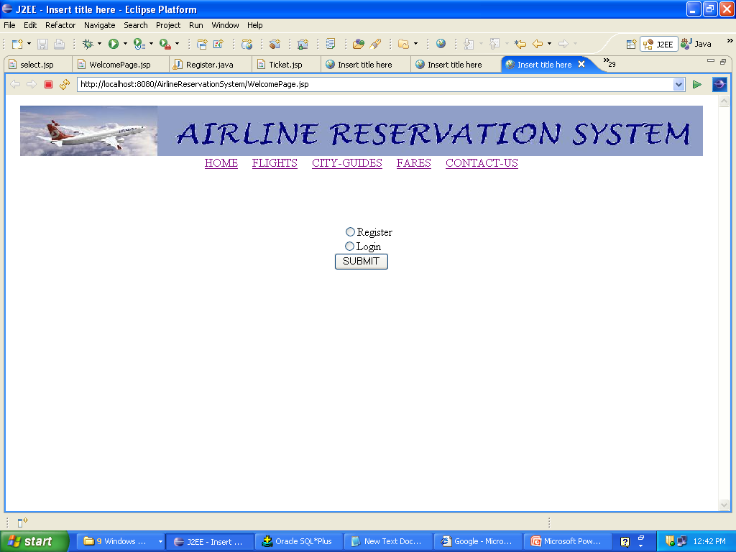

Slide 10
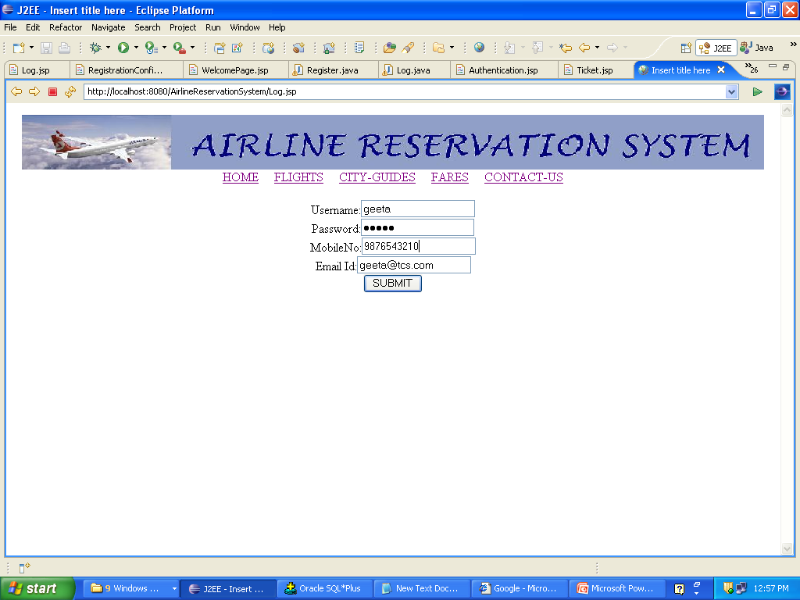
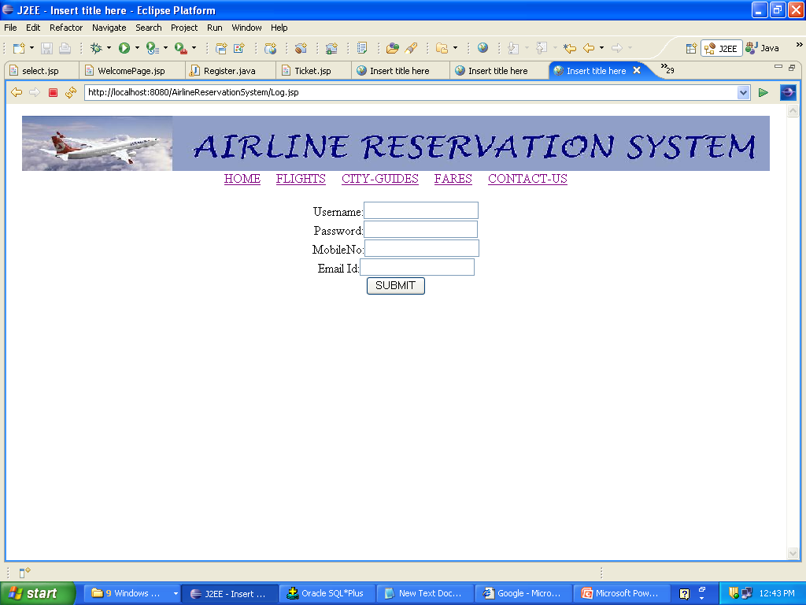
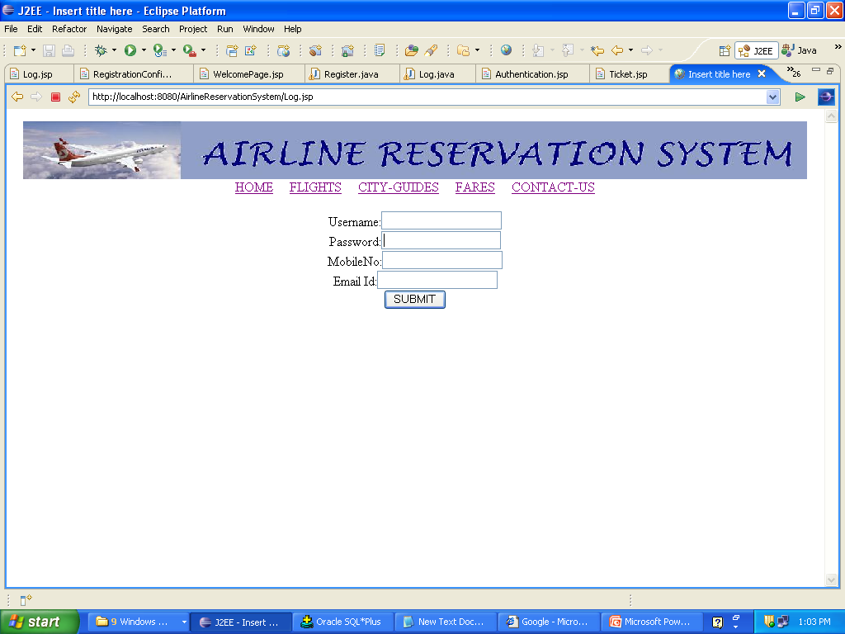

Slide 11
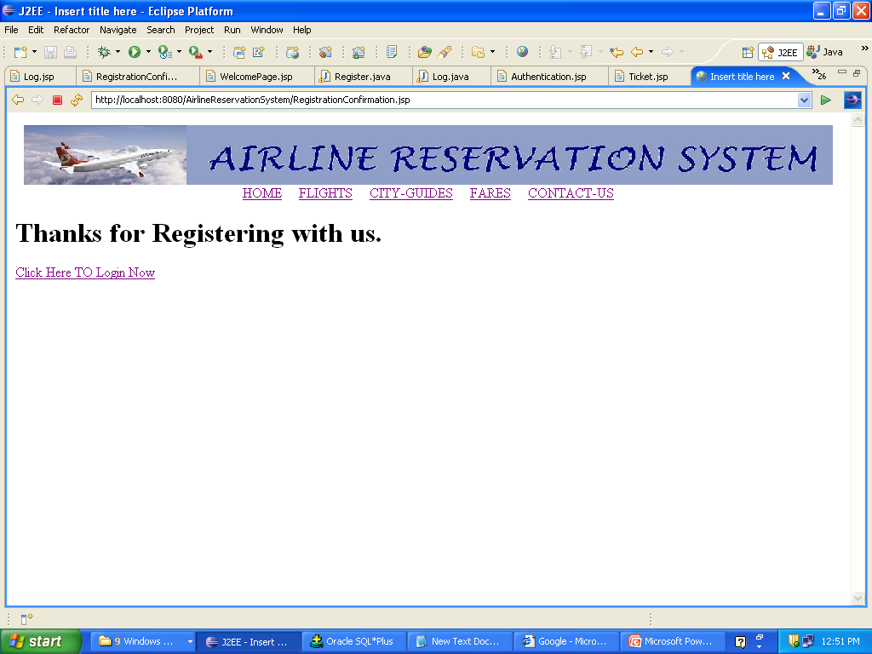

Slide 12
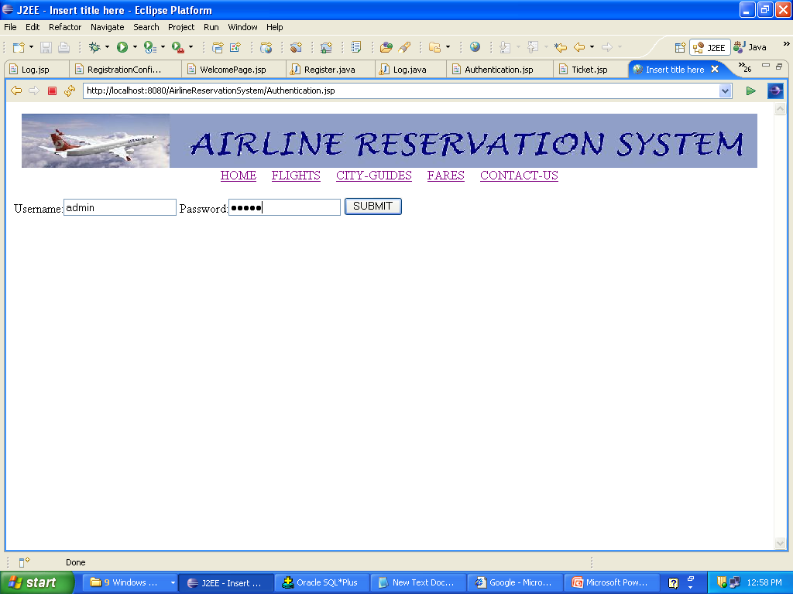
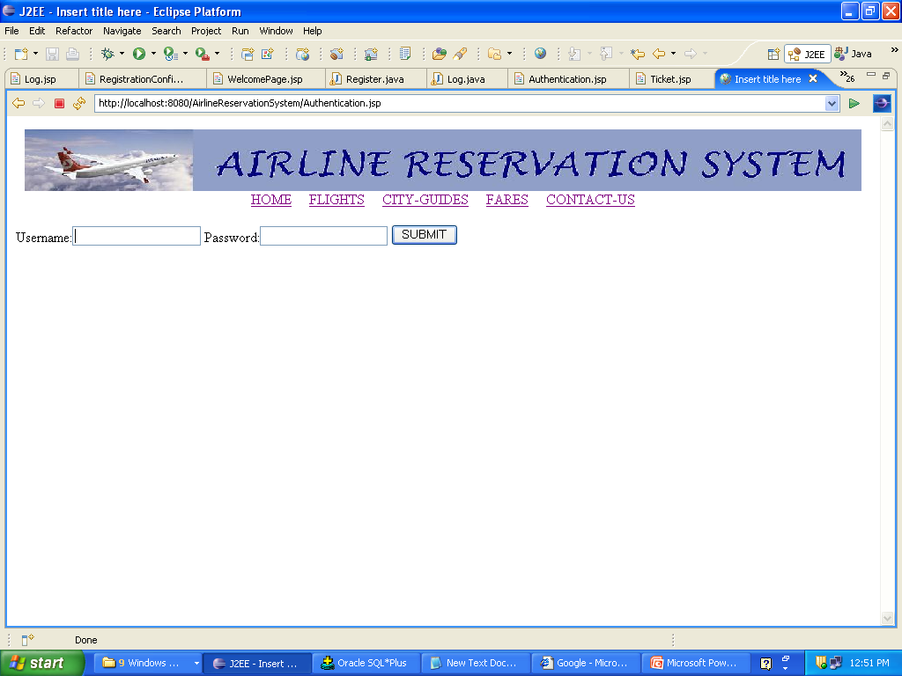

Slide 13
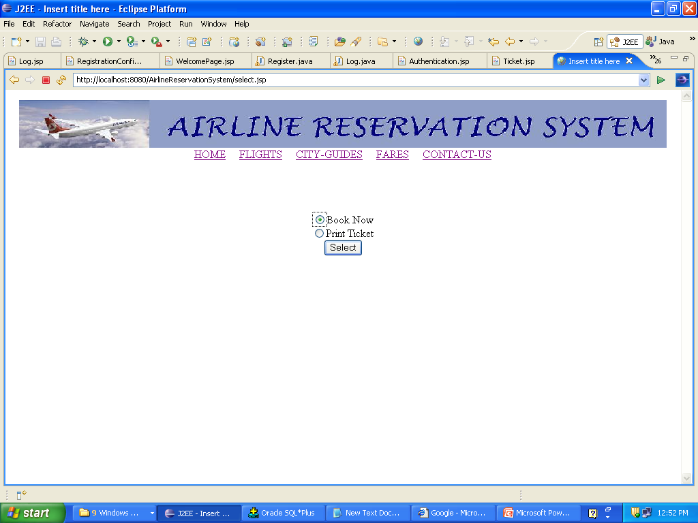
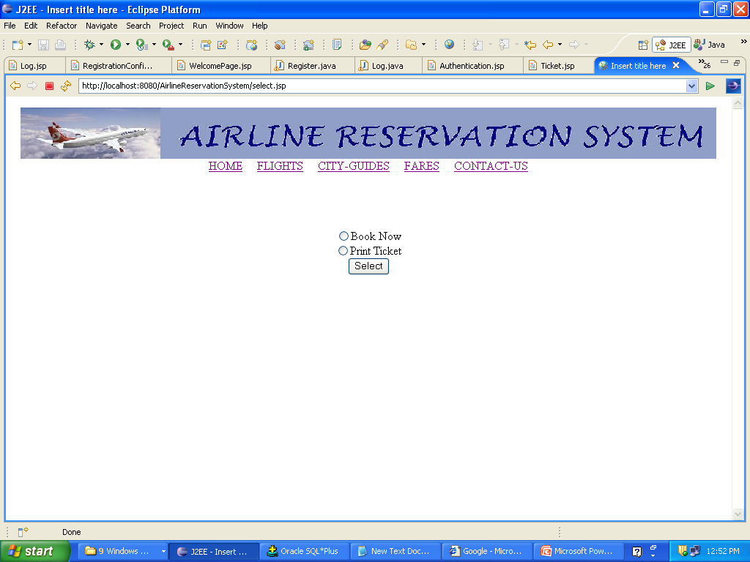

Slide 14
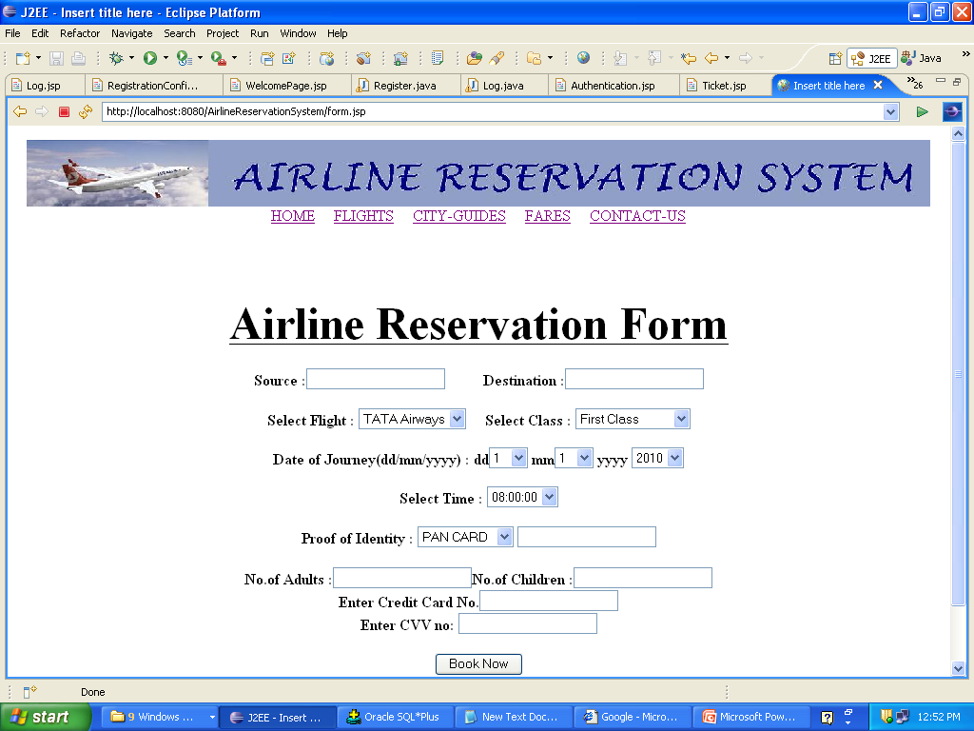
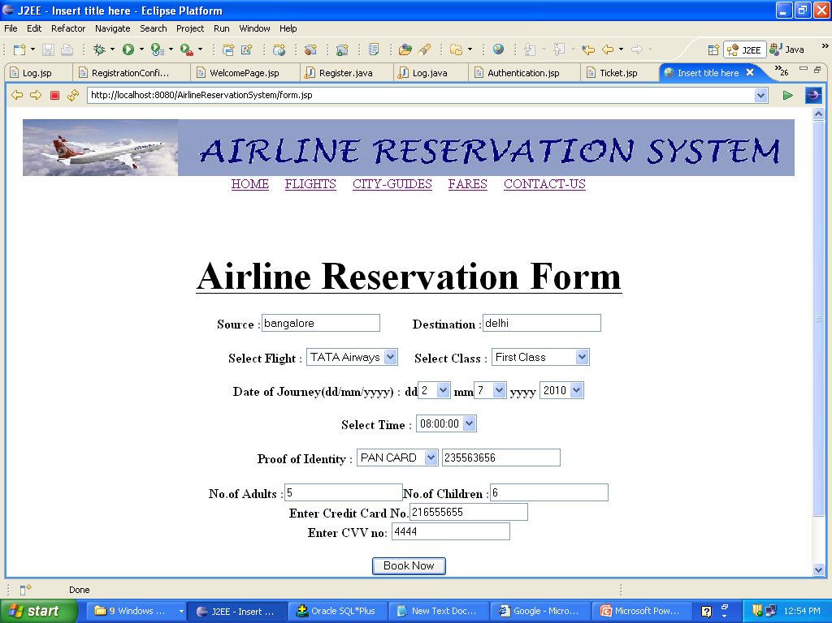

Slide 15
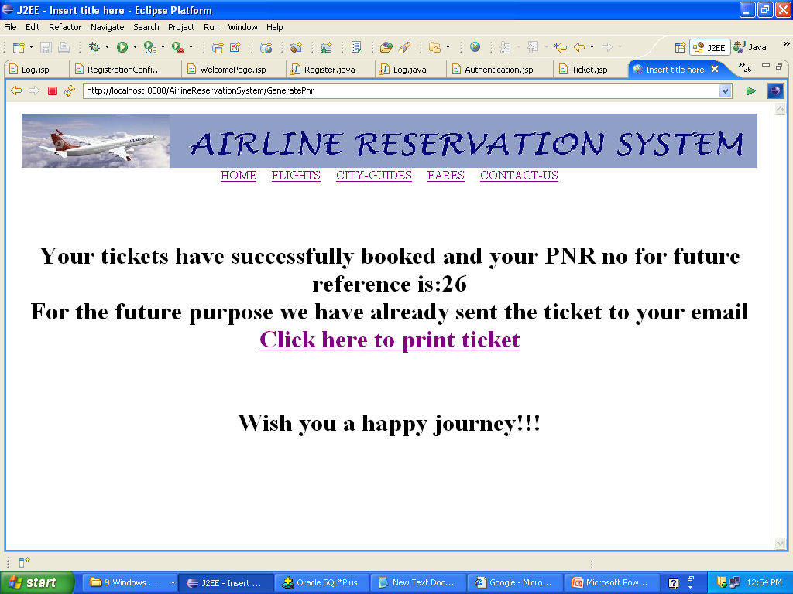

Slide 16


Slide 17
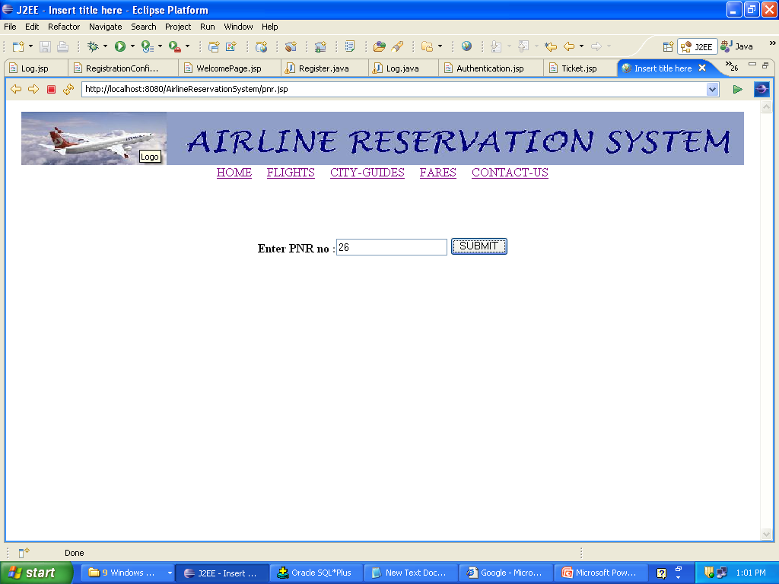

Slide 18
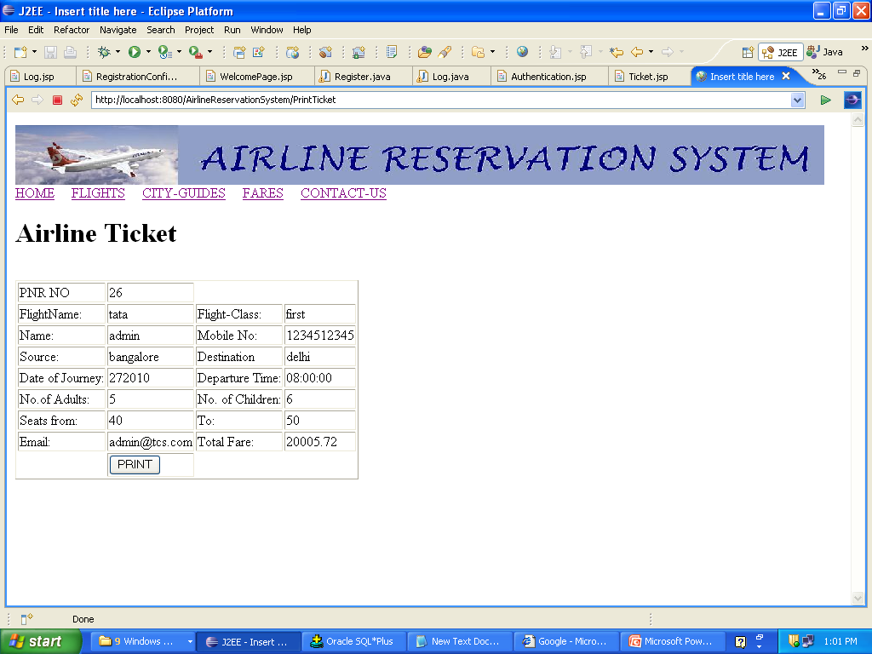

Slide 19
THANK YOU

